Slide 1
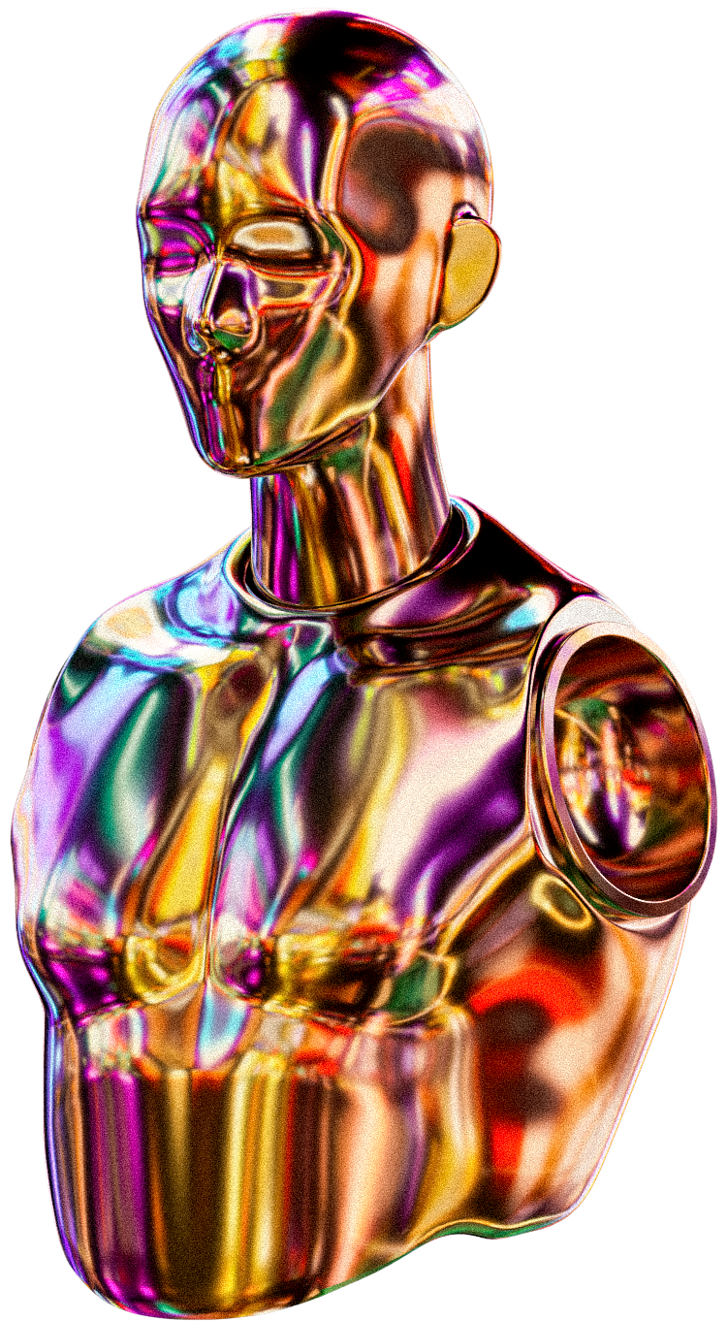
BHARATH:
DEVELOPER
DEVESH:
AZURE ENGINEER
HABEEB:
PROMPT ENGINEER
KANIKA:
AZURE ENGINEER
YESIRAT:
PROJECT MANAGER
SUPPORTEDGE
AI-POWERED COACHING FOR INCLUSIVE WORKPLACES
Presented By: Group 5
Microsoft Innovation Challenge 2025

Slide 2

Understanding Supported Employment
Supported employment is designed to help individuals with disabilities and other employment barriers secure and maintain jobs by providing essential services such as job coaching, skills training, and ongoing assistance. However, job coaches, who play a critical role in this process, face several challenges, including a high administrative workload, limited resources, and the need to provide personalized support while effectively managing job matching and training.
These challenges highlight the importance of improving support systems, as millions of people struggle with job access due to disabilities. Enhancing these systems can foster greater workforce inclusion and ensure that individuals receive the necessary guidance to succeed in their careers.

Slide 3

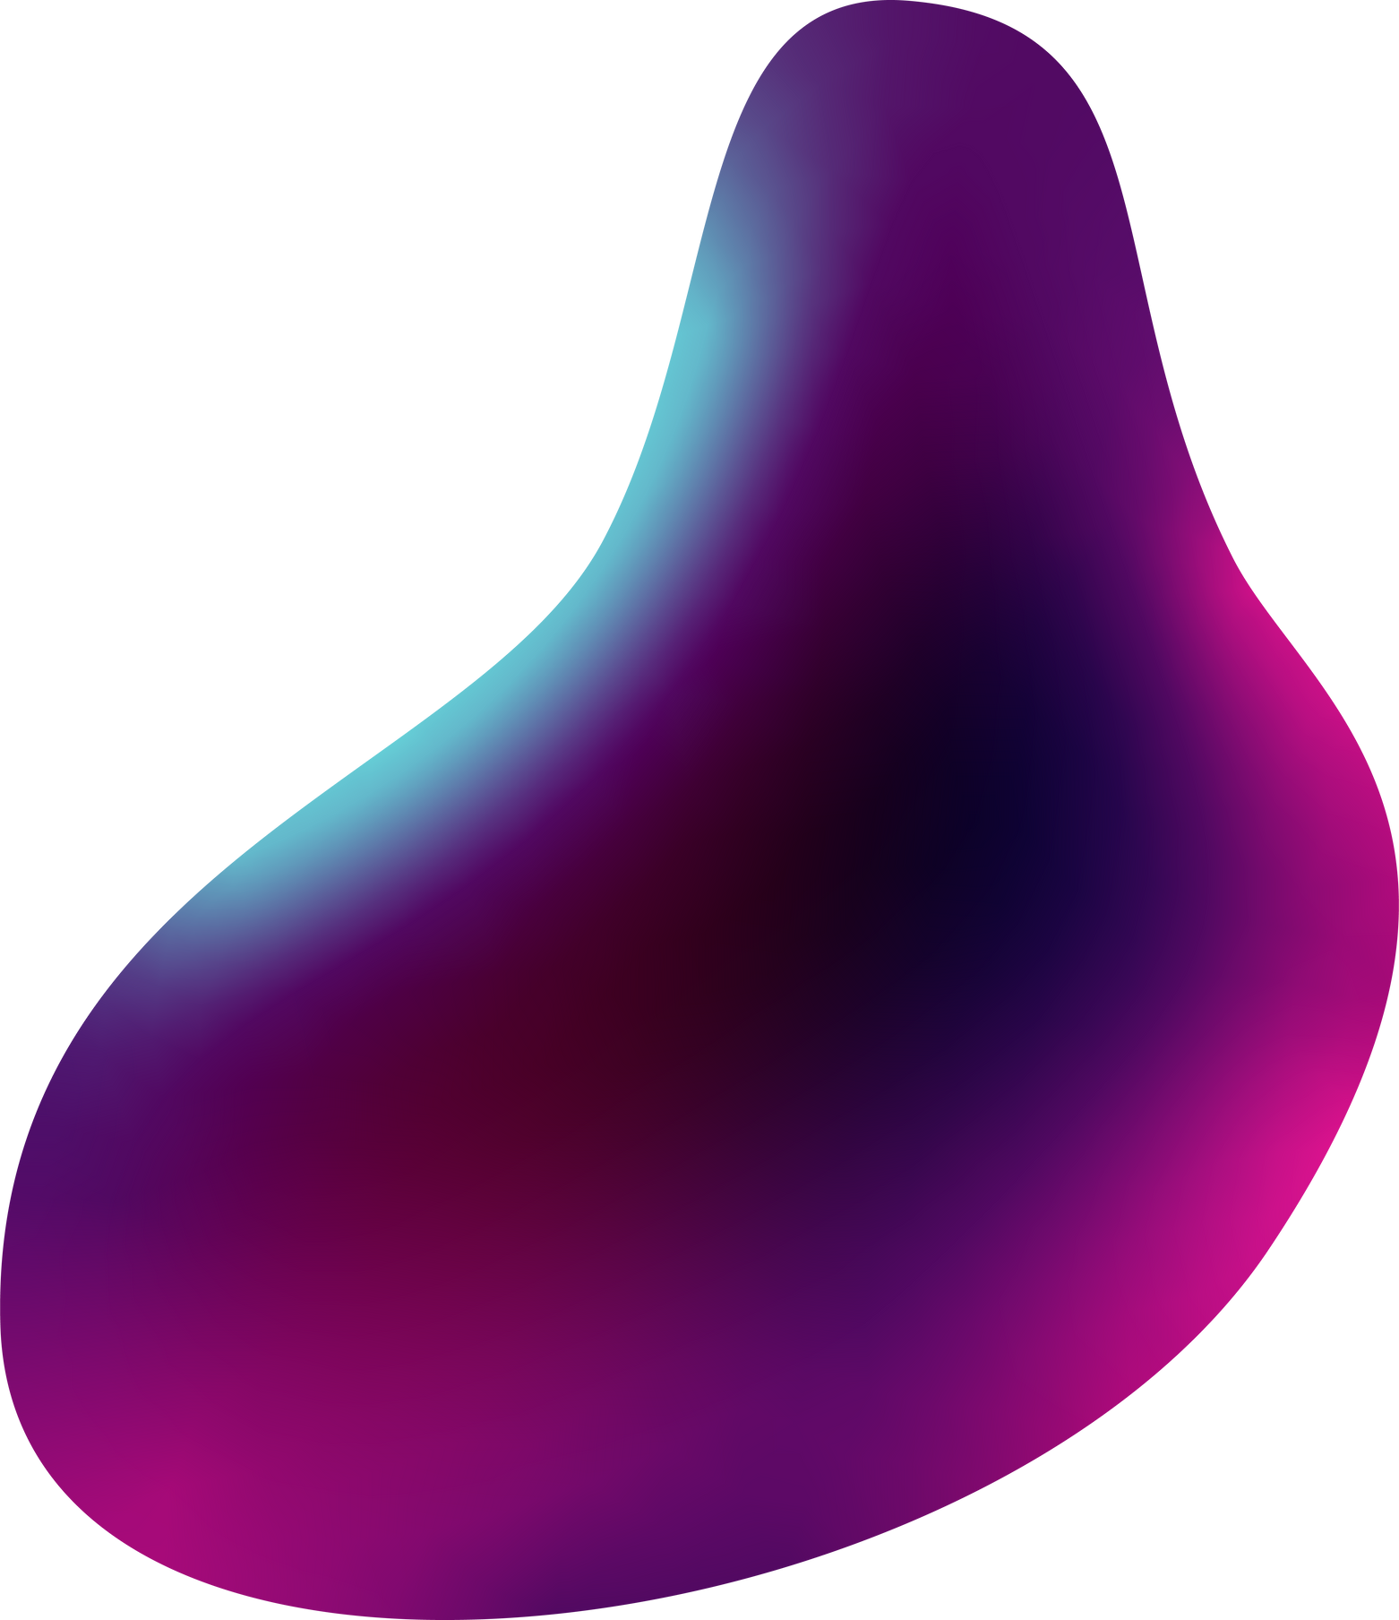
Thought Process & Development Approach.
Identifying Gaps
Analyzed challenges job coaches face, including high workloads and limited resources.
User-Centered Design:
Built an inclusive, accessible platform tailored to job coaches and job seekers with disabilities.
AI-Powered Efficiency
Integrated AI to automate tasks, enhance job matching, and provide real-time support.
Data Security & Responsible AI
Ensured compliance with ethical AI standards, prioritizing fairness, privacy, and transparency.

Slide 4

Personal Story
WHY THIS MATTERS TO US
One of our teammates has been personally impacted by Irritable Bowel Syndrome (IBS), a recognized disability that significantly affects their ability to work long hours. Due to the condition, they face challenges in high-energy fields such as consulting and quantitative trading, where long, intense workdays are the norm.
Remote work has become essential for maintaining productivity and accessibility, allowing them to manage their condition while remaining professionally engaged. To seek support, they joined organizations like LimeConnect, which advocate for professionals with disabilities. Their experience reflects the struggles many individuals face in securing and sustaining employment, highlighting the need for better support systems.
Our solution aims to bridge this gap by empowering both job seekers and coaches with AI-driven tools that enhance accessibility, efficiency, and inclusivity in the workforce.

Slide 5

Our Solution
SUPPORTEDGE
SupportEdge is an AI-powered assistant designed to streamline job coaching for individuals with disabilities. It automates administrative tasks, enhances job matching, and provides personalized training support, allowing job coaches to focus on direct mentorship.
HOW IT HELPS:
AI-Powered Job Matching: analyzes candidates’ skills and preferences to recommend suitable jobs.
Chat-Based Guidance: Offers instant AI-driven support for job seekers and coaches, improving accessibility and efficiency.
Motivation and immediate gudiance: Answering basic questions that allow coaches on non-mundane tasks.
Automates Paperwork: Reduces time spent on documentation, progress tracking, and reporting.

Slide 6
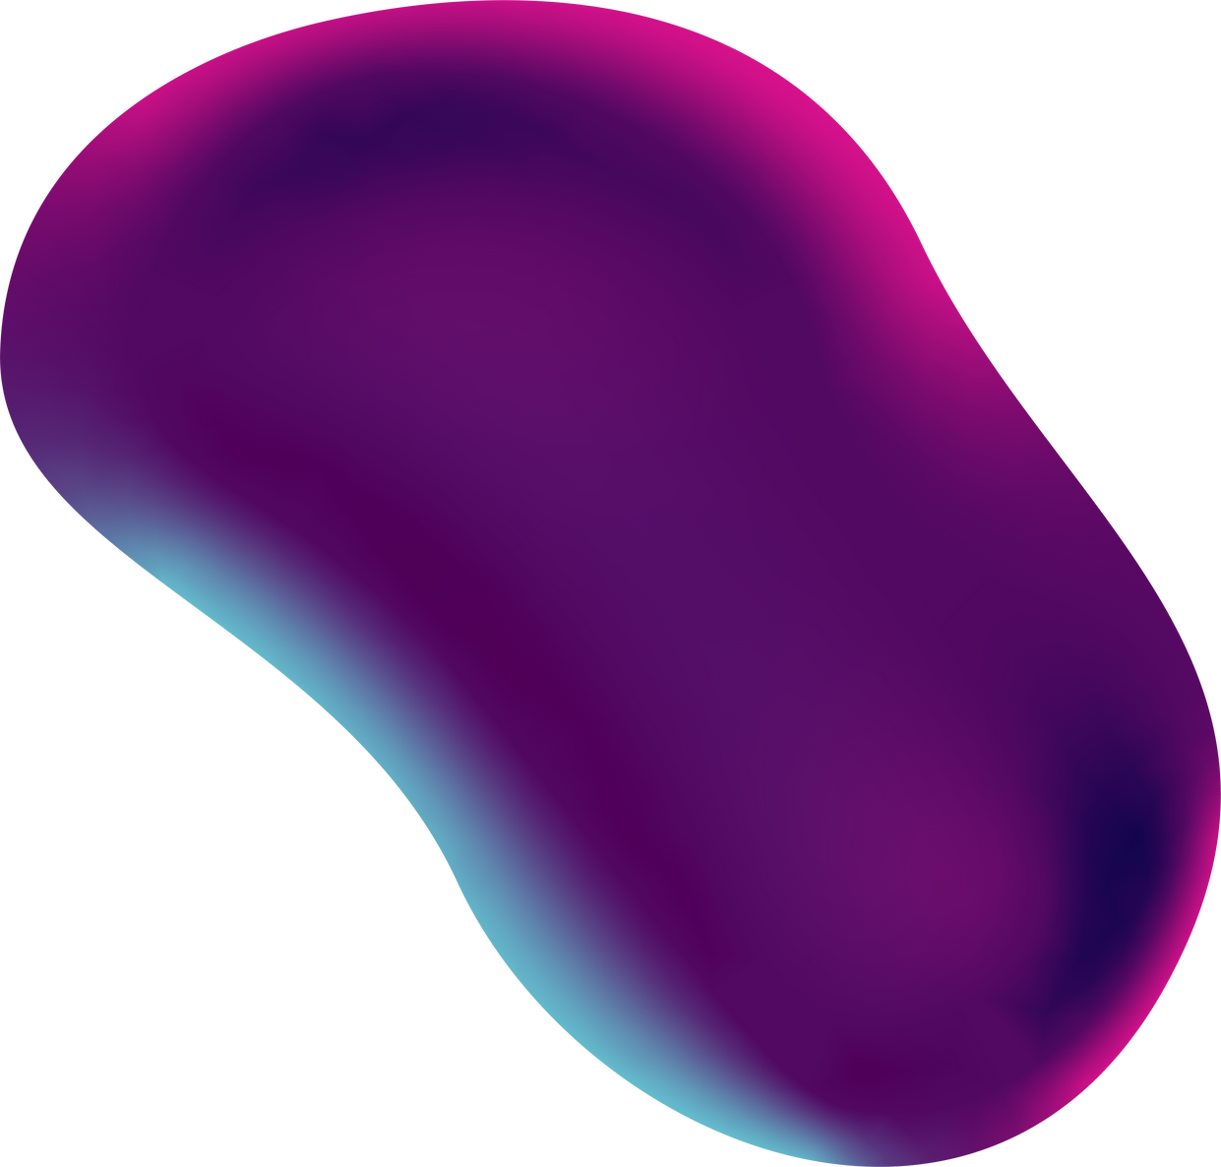

Key features
01
05
AI-POWERED CHATBOT
02
RESPONSIBLE AI COMPLIANCE:
04
Adheres to ethical AI standards for fairness, transparency, and inclusivity.
Provides instant answers and support for job coaches and job seekers.
SMART JOB MATCHING:
REMOTE-FRIENDLY SUPPORT:
03
Uses AI to recommend the best job opportunities based on skills and preferences.
AUTOMATED REPORTING
Ensures accessibility from any location for seamless coaching and assistance.
Streamlines documentation and tracking with Azure-powered efficiency.

Slide 7

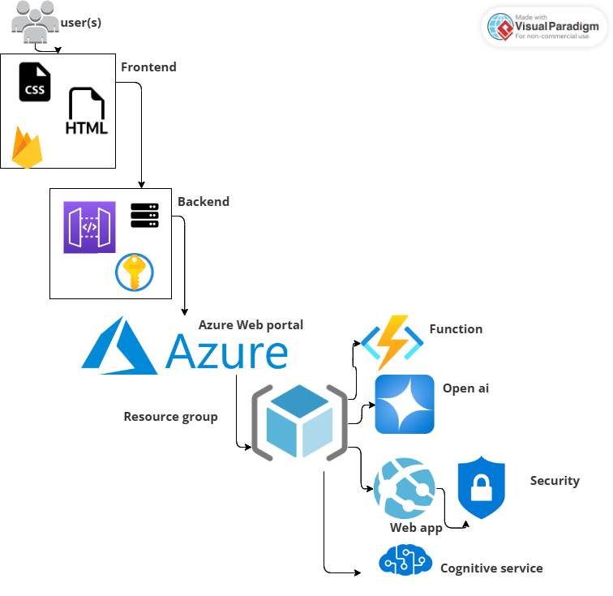
System Architecture & Tech Stack
KEY COMPONENTS:
Frontend (User Interface): React.js web application for job coaches and job seekers.
Backend (Business Logic & API Layer): Node.js with Express, handling requests and integrating AI services.
AI Layer (Intelligent Automation): Azure OpenAI and Cognitive Services for chat support, job matching, and insights.
Database (Data Storage & Management): Azure SQL for secure storage of user profiles, job data, and session history.
Cloud & Hosting: Azure Functions for serverless execution, Azure Storage for file management, and API Management for secure communication.
This architecture ensures high availability, scalability, and efficiency, leveraging Microsoft’s Azure ecosystem to optimize job coaching and supported employment

Slide 8
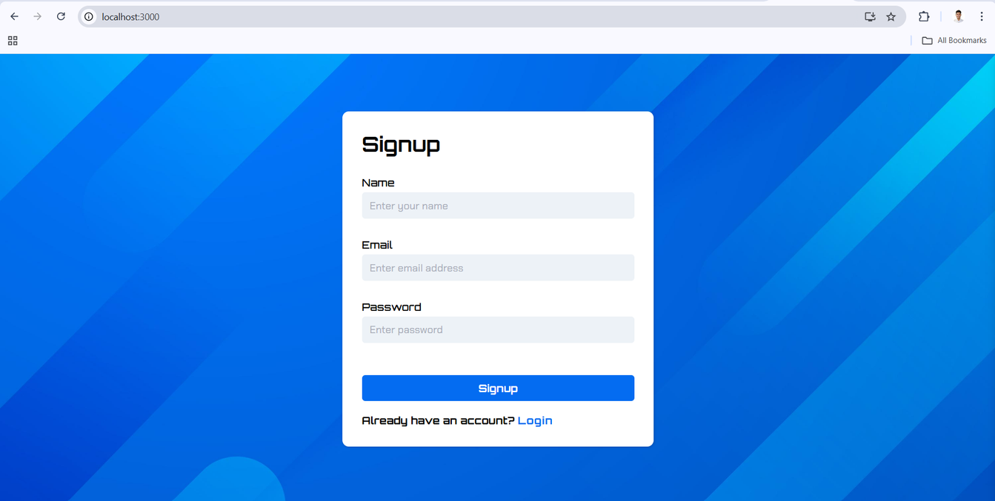

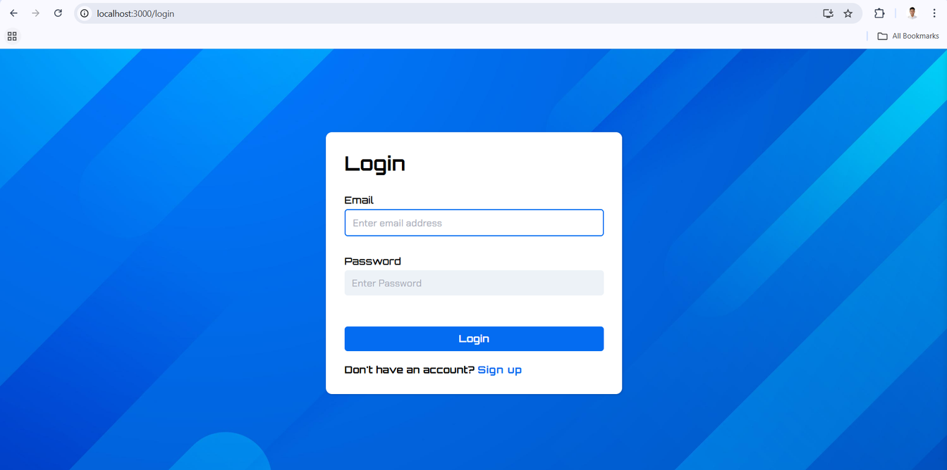
Demo
Authentification

Slide 9
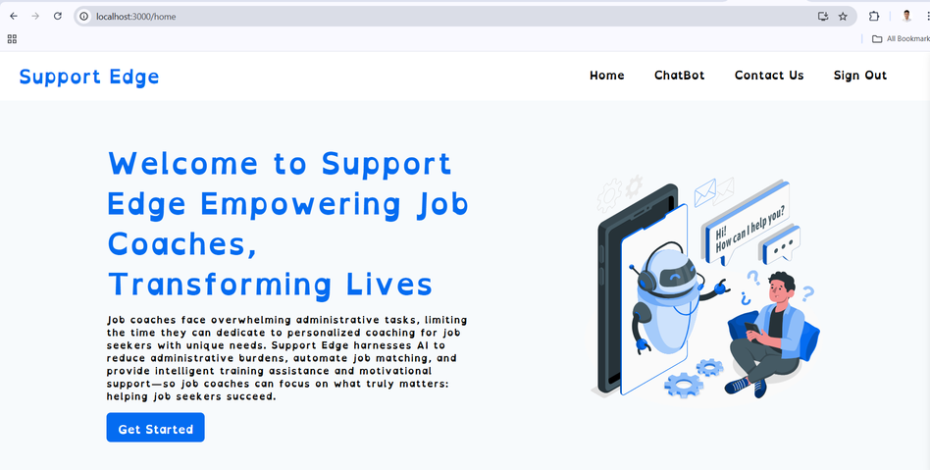
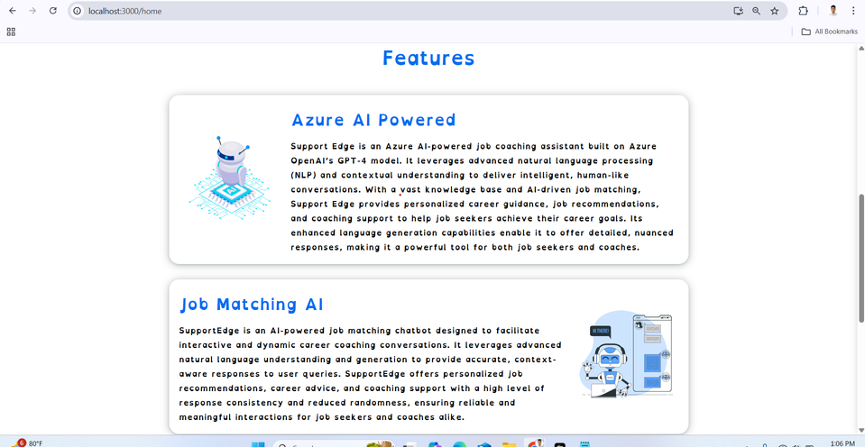
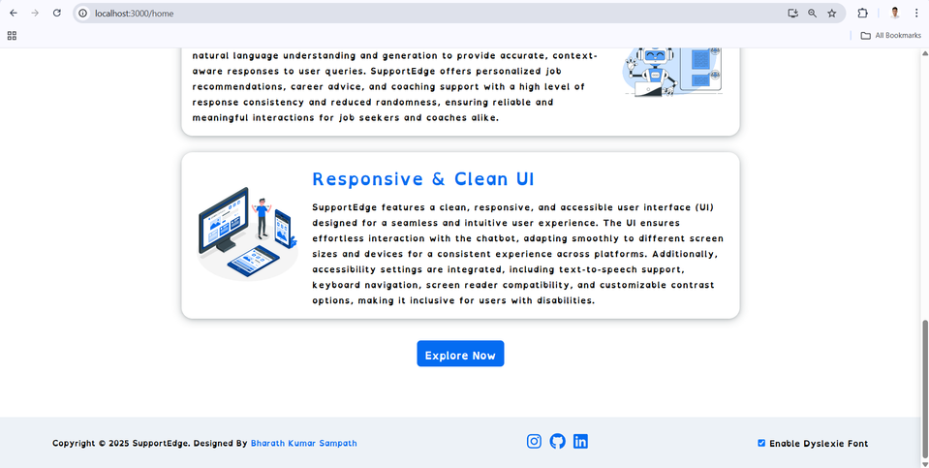
Welcome page with Dyslexic font type to improve readability

Slide 10
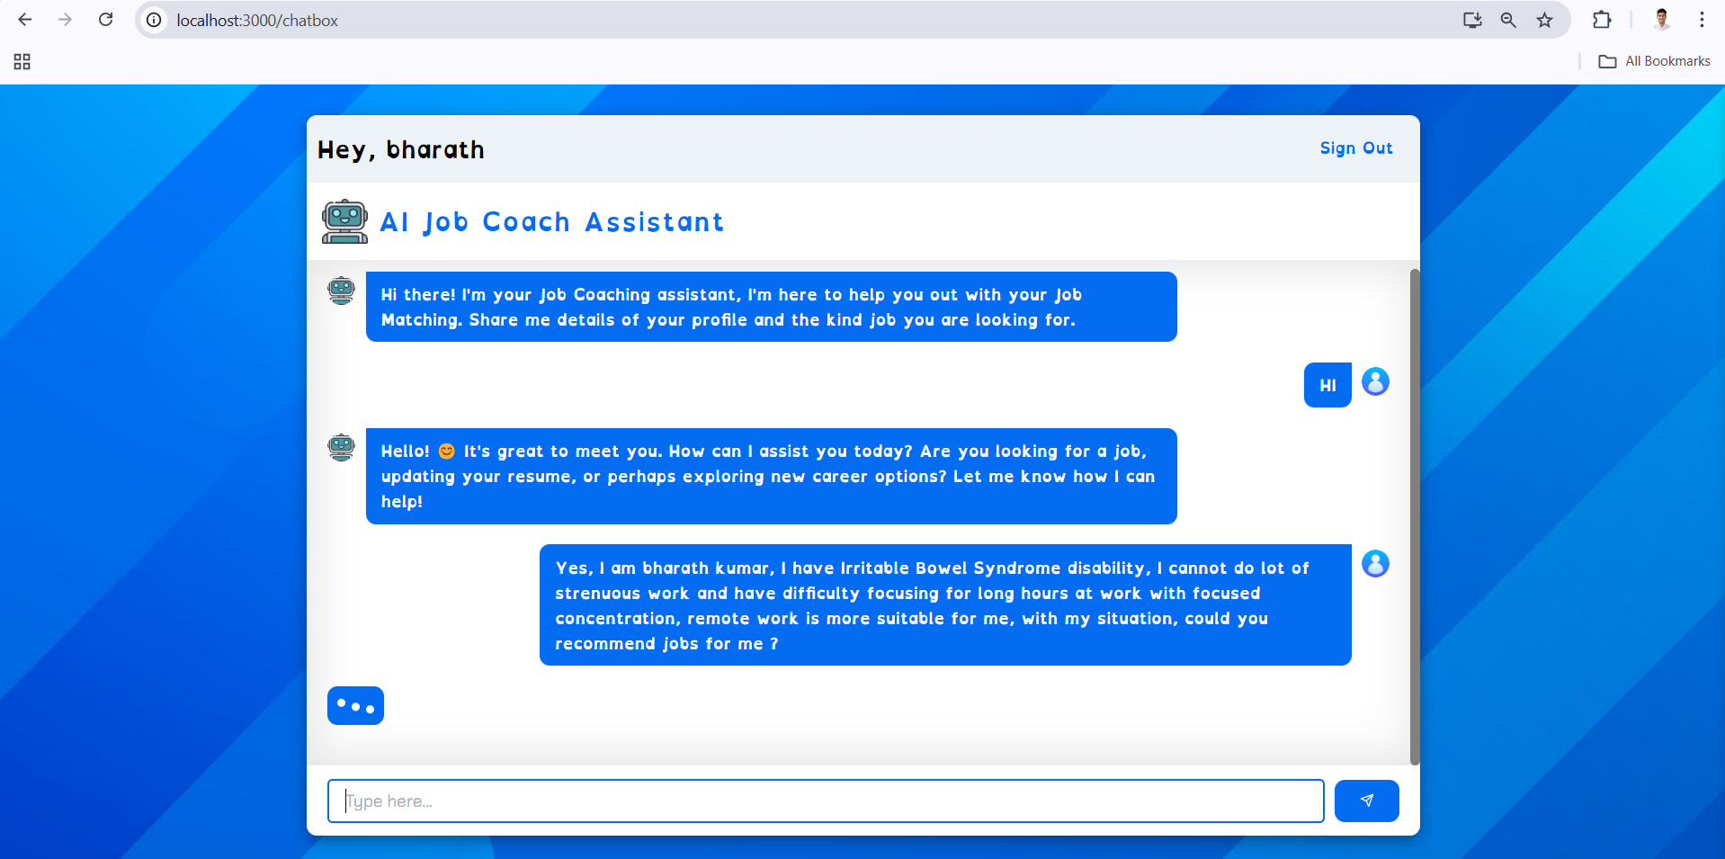
Examples of AI-driven job matching & chat interactions

Slide 11
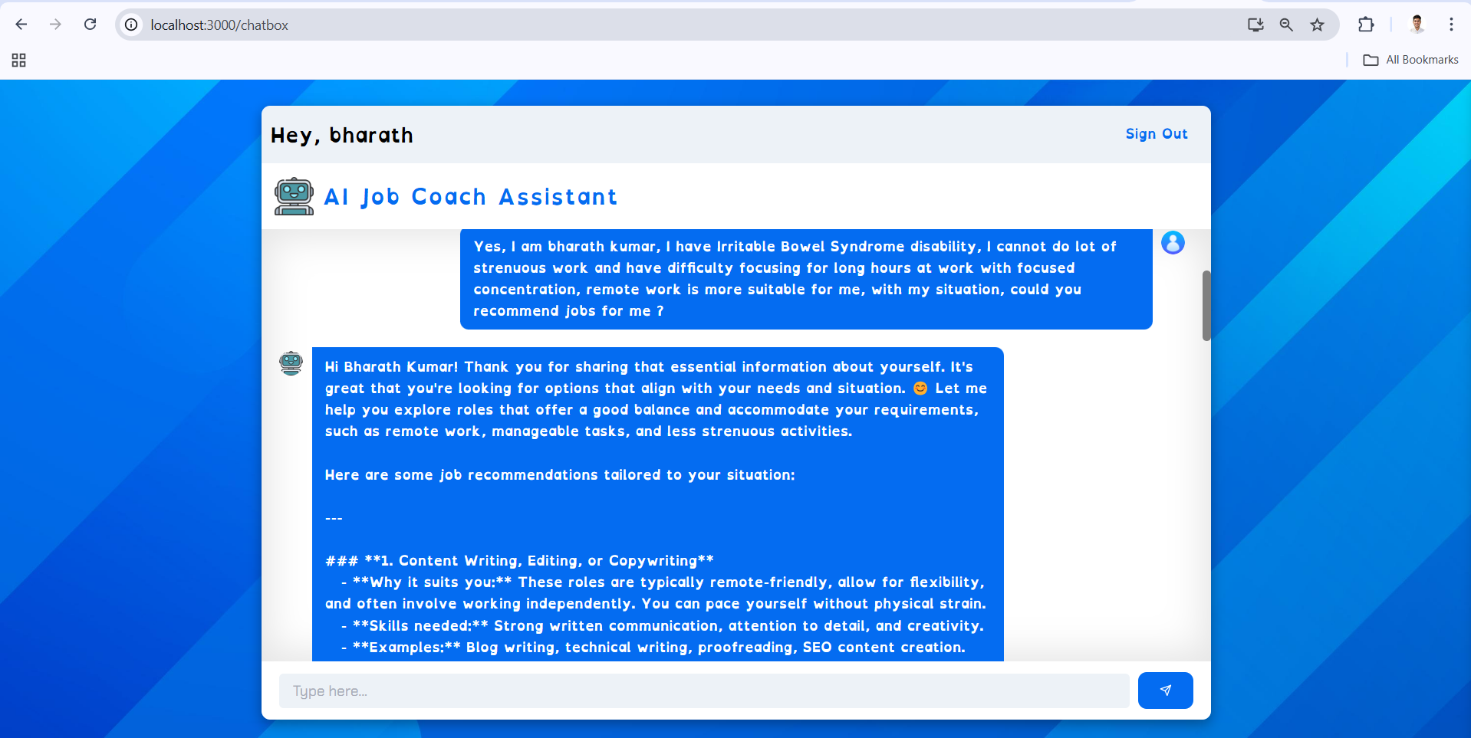
User Interface showcasing accessibility features, find a lint to video demo

Slide 12
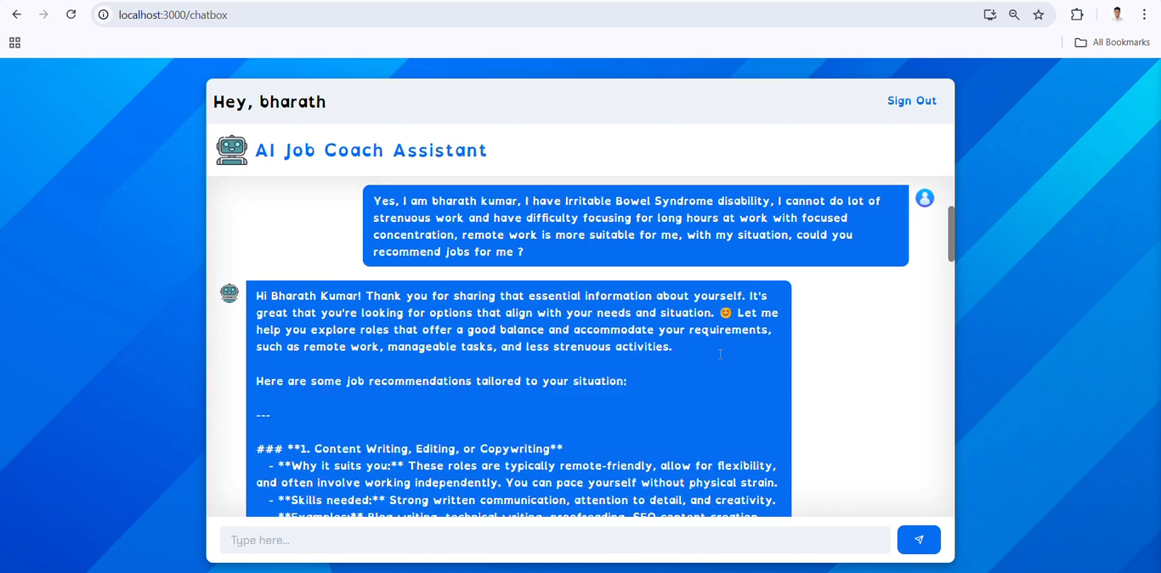

Slide 13
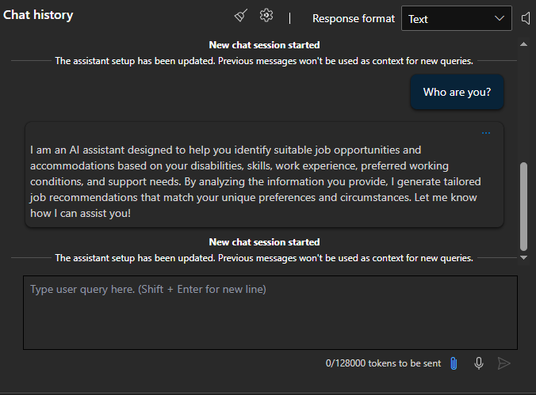
Training the model

Slide 14
truction for the Assistant:
"Assist [Name] in identifying suitable job roles based on their skill set, disability accommodations, and preferred working conditions, then create tailored recommendations for job search and workplace success. Use the provided raw data to analyze their needs, strengths, and preferences, while addressing any support services like job coaching, transportation, and accommodations."
Example Raw Data for Processing:
{
"User": {
"Name": "Alex",
"Skills": ["Power Systems", "Circuit Design", "Project Management"],
"Disability": ["Dyslexia"],
"SupportNeeds": ["Job Coaching"],
"PreferredJobType": "Full-time",
"PreferredWorkingConditions": ["Flexible Schedule", "Remote"],
"TransportationNeeds": ["Accessible Public Transport"]
},
"JobsAvailable": [
{
"Title": "Electrical Engineer",
"SkillsRequired": ["Power Systems", "Circuit Design"],
"WorkType": "Full-time",
"WorkingCondition": ["Flexible Schedule", "In-Office"],
"Location": "Downtown Office"
},
{
"Title": "Project Manager",
"SkillsRequired": ["Project Management", "Communication"],
"WorkType": "Full-time",
"WorkingCondition": ["Remote"],
"Location": "Remote"
},
{
"Title": "Technical Writer",
"SkillsRequired": ["Technical Documentation", "Editing"],
"WorkType": "Part-time",
"WorkingCondition": ["Flexible Schedule", "Remote"],
"Location": "Remote"
}
]
}

Slide 15
How the Machine Learning Model Could Process This:
Input Analysis:
User's profile: Analyze Alex's disability (Dyslexia), preferred conditions (Full-time, flexible schedule, remote), and required support (Job Coaching, accessible public transport).
Skills: Match Alex's skills against available job roles.
Filtering Jobs:
From the "JobsAvailable" dataset, filter roles based on the intersection of:
Skills match (e.g., Alex has Power Systems and Project Management for relevant jobs).
Work type (Alex prefers full-time roles).
Flexible conditions for Dyslexia accommodations (e.g., consider jobs that are remote or flexible).
Potential challenges (onsite roles may not meet Alex's transportation needs).
Scoring Jobs:
Assign a relevance "score" based on how well the job aligns with Alex’s:
Skills.
Disability accommodations.
Support and transportation needs.
Example:
"Project Manager" matches many criteria (full-time, remote) – higher score.
"Electrical Engineer" aligns with skills but isn’t remote or easily accessible – lower score.
Output Recommendations:
Ranked job suggestions with explanations:
Recommendation 1: Project Manager – Matches all skills and conditions.
Recommendation 2: Electrical Engineer – Matches skills but might require transportation adjustments.
Recommendation 3: Technical Writer – Doesn’t fully match skills but allows flexibility.
Example Output for the Assistant:
"Based on Alex's profile and preferences, the following roles are recommended:
Project Manager:
Skills Matched: [Project Management]
Conditions Met: Full-time, remote, flexible schedule.
Suggested Next Step: Tailor resume to highlight Project Management and apply for this role.
Electrical Engineer:
Skills Matched: [Power Systems, Circuit Design].
Conditions Partly Met: Full-time, flexible schedule, but transportation needs may require accommodation.
Suggested Next Step: Explore transportation support options and seek workplace accessibility.
Technical Writer:
Skills Misaligned, but provides flexibility for Dyslexia.
Suggested Next Step: Develop applicable skills (e.g., Technical Documentation) or use as backup option."

Slide 16
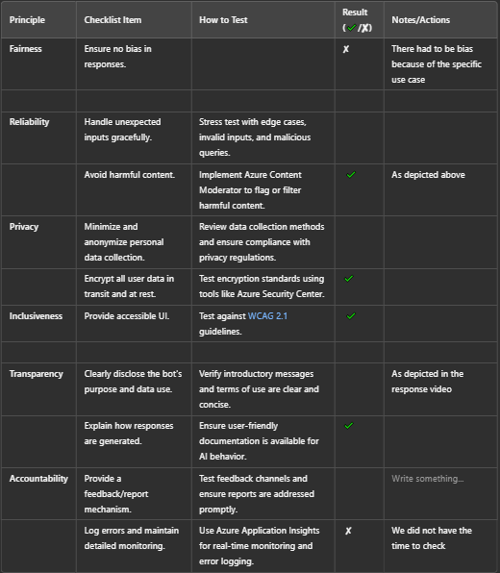
Compliance

Slide 17
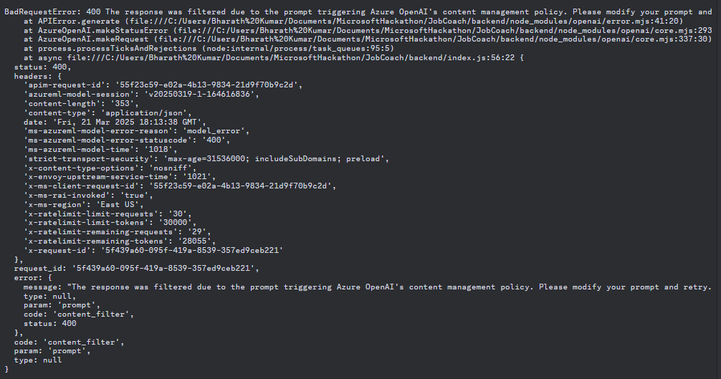

Slide 18
Potential Expansion
Future Scope & Impact
Advanced AI coaching and personalized training modules.
Enhanced accessibility features like voice input and multilingual support.
Collaborations with employment services and organizations like LimeConnect, etc.
Fix minor bugs, such as return text in the chat bot.
Further train the model to ensure proper validation.
Support multiple languages and regional variations.
Long-Term Goal:
Boost employment opportunities for people with disabilities.
Scale supported employment with AI-driven efficiency and inclusivity.

Slide 19
Challenges & Key Learnings
Setting up Azure resources and integrating AI models efficiently.
Ensuring accessibility features align with real user needs.
Training AI to provide fair, bias-free job recommendations
Varying time zones within the group.
Varying engagement level within the group
Team-wise
Task-Wise
As a team of individuals with diverse backgrounds, locations, and commitments, it was challenging to align on certain decisions and work cohesively within the short timeframe. There was a lot of back-and-forth communication and sacrifices required to ensure we ultimately reached our goal.
Picking up a new skill and applying it immediately was new for a lot of us.
We all did not feel confident enough for some of the task that were assigned.

Slide 20
Key Takeaways
A lot of the challenges posed were sometimes deterring, but, with a little push from one teammate or the other, it became a fun learning curve.
We also made conscious efforts to ensure that we were not too distracted by the challenge. Making conscious efforts to consider the user , made the project and learning more wholesome
Team-wise
Task-wise
As the project drew to an end and we reminces on the experince, for some of us this was the first Hacakathon ever, and completing the project brought on a wave of immense and inexplicable emotions.
Some member of the team have agreed to be teammates beyond this hacakthon
The true beauty of project-based learning is the resulting confidence.

Slide 21
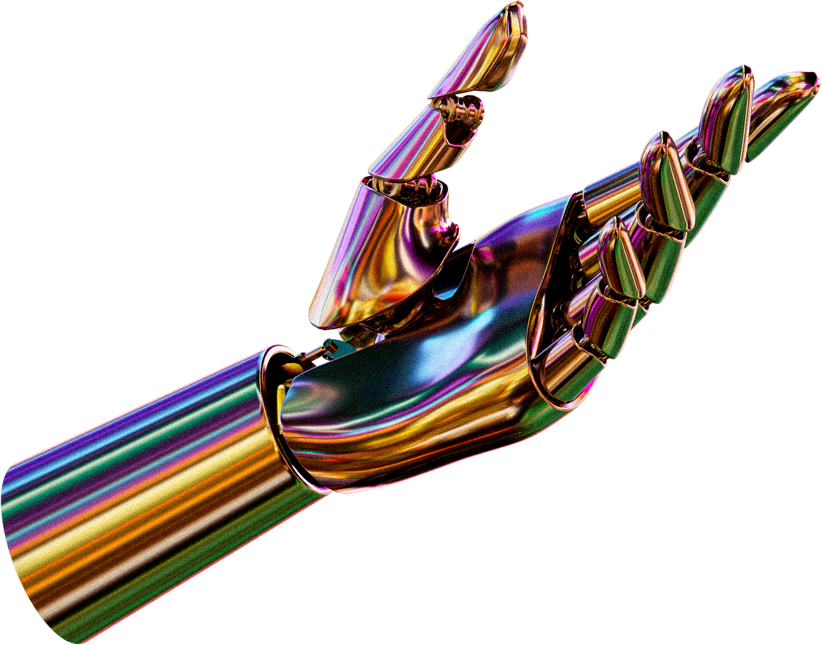
BHARATH: BHARATHKUMARSAMPATH.ME@GMAIL.COM
DEVESH: SBDEVESH28@GMAIL.COM
HABEEB: SANNIHABEEBO30@GMAIL.COM
KANIKA: KANIKABASKAR13@GMAIL.COM
YESIRAT: YESIRAT.SANNI_UG2023@ASHOKA.EDU.IN
THANK YOU
FOR YOUR ATTENTION
Presented By: Yesirat Sanni
Contact us
GitHub
Appreciation notes to:
Noah Feldman
Santhiswaroop Naik
Meelinda Carrion
NB: We have also worked on this project with the help of ChatGPT to debug errors amongst other mundane tasks.

